Slide 1
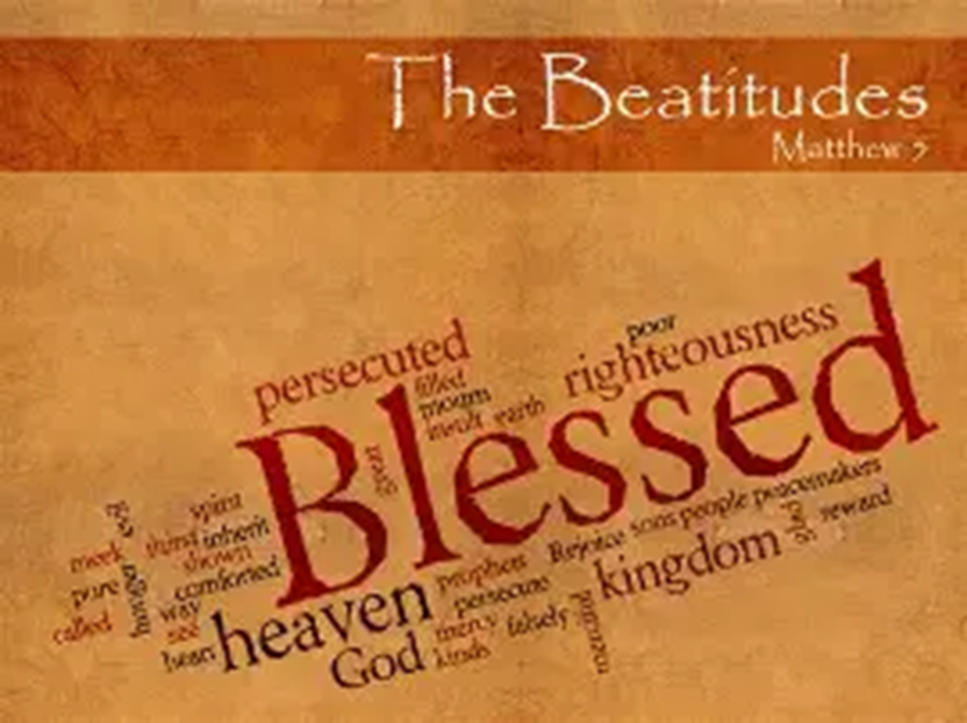
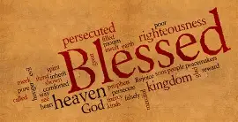
Welcome to First Mennonite Church
The Beatitudes
- Matthew 5

Slide 2
Call to Worship
L: Come, all who carry sorry, all who know loss, disappointment, or ache.
P: We come with heavy hearts and open hands.
L: Blessed are those who mourn, said Jesus, for God meets us in our grief with gentle, healing presence.
P: We come to find comfort – not escape; to bring our tears – not to hide them; to be held by the One who weeps with us.
ALL: Let us worship the God who does not look away but draws near to the brokenhearted.

Slide 3
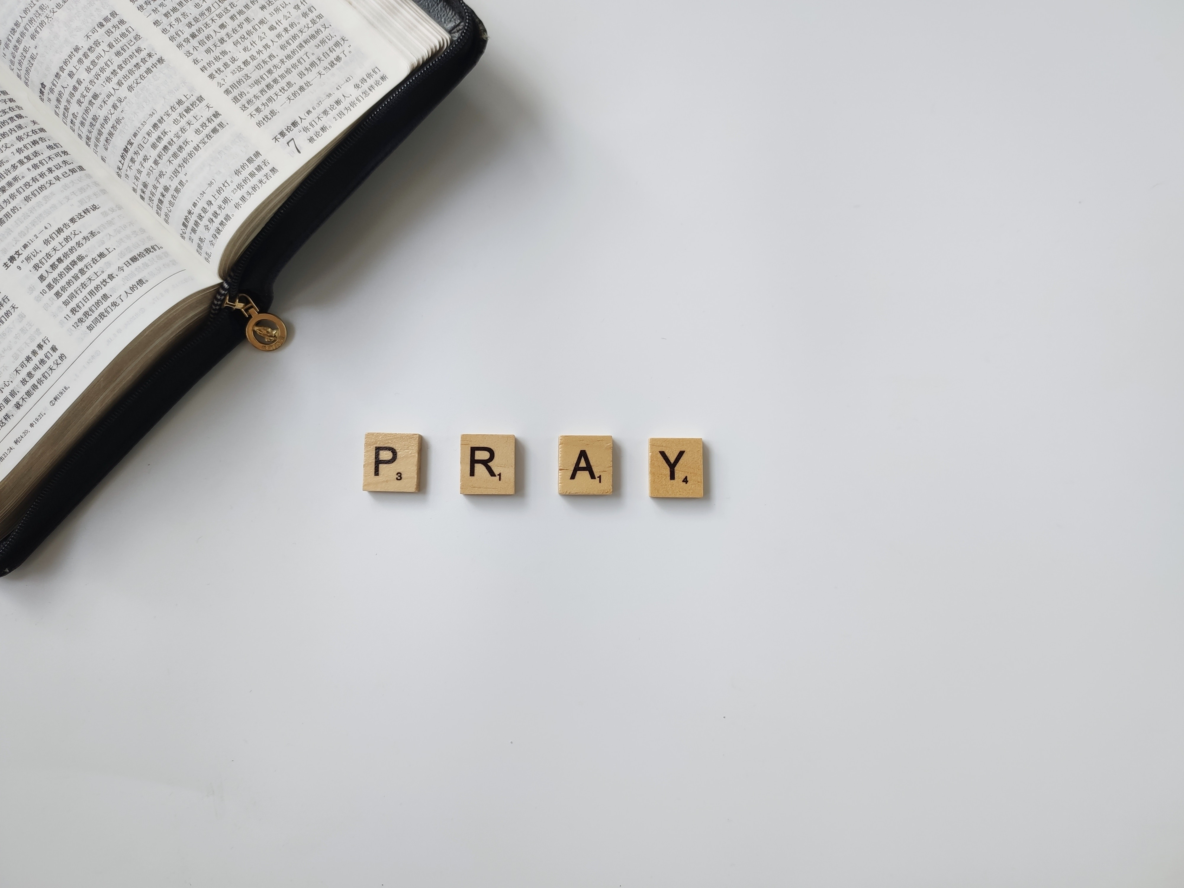
PRAYER

Slide 4
VT 420
God of the Bible, God in the gospel,
hope seen in Jesus, hope yet to come,
you are our center, daylight or darkness,
freedom or prison, you are our home.
Fresh as the morning, sure as the sunrise,
God always faithful, you do not change.
Fresh as the morning, sure as the sunrise,
God always faithful, you do not change.

Slide 5
God in our struggles, God in our hunger,
suffering with us, taking our part,
still you empow’r us, mothering Spirit,
feeding, sustaining, from your own heart.
Fresh as the morning, sure as the sunrise,
God always faithful, you do not change.
Fresh as the morning, sure as the sunrise,
God always faithful, you do not change.

Slide 6
Those without status, those who are nothing,
you have made royal, gifted with rights,
chosen as partners, midwives of justice,
birthing new systems, lighting new lights.
Fresh as the morning, sure as the sunrise,
God always faithful, you do not change.
Fresh as the morning, sure as the sunrise,
God always faithful, you do not change.

Slide 7
Not by your finger, not by your anger
will our world order change in a day,
but by your people, fearless and faithful,
small paper lanterns, lighting the way.
Fresh as the morning, sure as the sunrise,
God always faithful, you do not change.
Fresh as the morning, sure as the sunrise,
God always faithful, you do not change.

Slide 8
Hope we must carry, shining and certain
through all our turmoil, terror and loss,
bonding us gladly one to the other,
till our world changes, facing the cross.
Fresh as the morning, sure as the sunrise,
God always faithful, you do not change.
Fresh as the morning, sure as the sunrise,
God always faithful, you do not change.
Text: Shirley Erena Murray, ©1996 Hope Publishing Co. Music: Tony E. Alonso, ©2001 GIA Publications, Inc. Reprinted & Streamed with permission under One License A-740029. All rights reserved.

Slide 9
Confession and Assurance
L:Let us come before God with honest hearts, bringing our pain and our silence, our numbness and our fear.
(pause for reflection)
L: God of mercy, we confess that we are slow to mourn.
P: We numb our sorrow, dismiss our pain, and rush past the grief of others.

Slide 10
L: We are quick to offer platitudes when what is needed is presence.
P: We have tried to carry burdens alone and have turned away from the pain of the world.
L: Forgive us. Teach us to lament with honesty, to mourn with hope, and to trust that even our tears are sacred to you. Amen.

Slide 11
Assurance of Pardon
L: Hear the good news: The One who calls you to mourn is the same One who promises comfort. Jesus wept, so that we would know our tears are not weakness. Jesus rose, so that we would know grief is not the end of the story. As sure as Christ lives, you are seen, you are loved, and in him, you are forgiven.
ALL: Thanks be to God. Amen.

Slide 12

VT 620
In the bulb there is a flower; in the seed, an apple tree; in cocoons, a hidden promise: butterflies will soon be free! In the cold and snow of winter there’s a spring that waits to be, unrevealed until its season, something God alone can see.

Slide 13
There’s a song in ev’ry silence,
seeking word and melody.
There’s a dawn in ev’ry darkness, bringing hope to you and me.
From the past will come the future;
what it holds, a mystery,
unrevealed until its season,
something God alone can see.

Slide 14
In our end is our beginning;
in our time, infinity;
in our doubt there is believing;
in our life, eternity.
In our death, a resurrection;
at the last, a victory,
unrevealed until its season,
something God alone can see.
Text and Music: Natalie Sleeth, 1985. ©1986 Hope Publishing Co Reprinted & Streamed with permission under One License A-740029. All rights reserved.

Slide 15
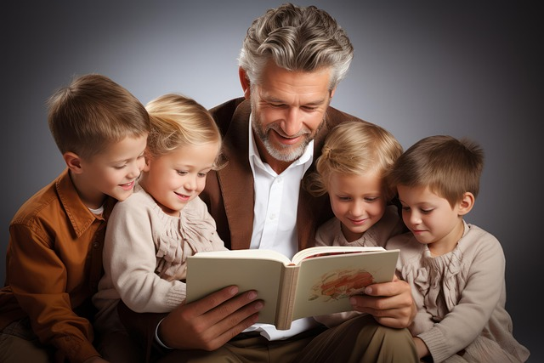
Children’s Story

Slide 16
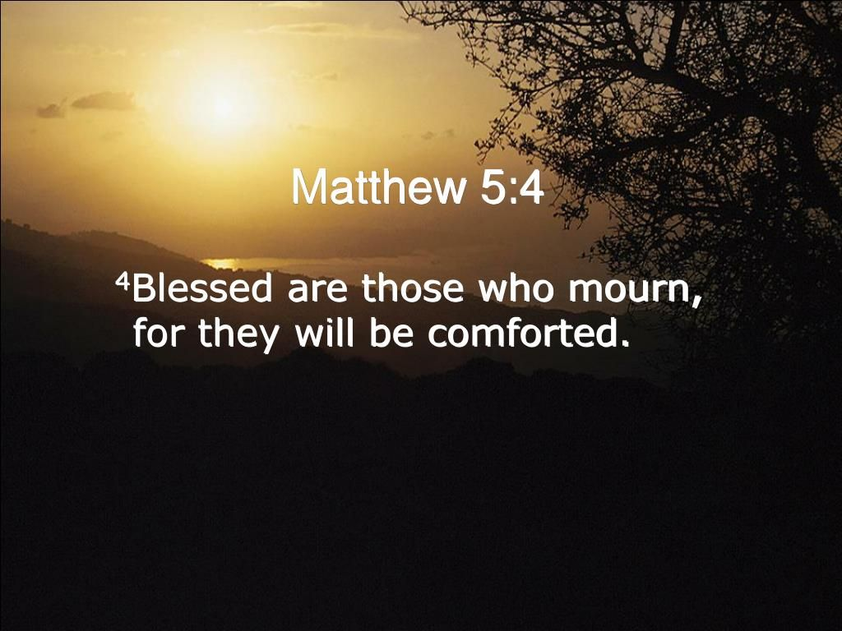
Message: “Grief as Grace”

Slide 17
VT 653
Nothing is lost on the breath of God, nothing is lost forever;
God’s breath is love, and that love will remain,
holding the world forever.
No feather too light, no hair too fine,
no flower too brief in its glory;
no drop in the ocean, no dust in the air, but is counted and told in God’s story.

Slide 18
Nothing is lost to the eyes of God, nothing is lost forever.
God sees with love,
and that love will remain,
holding the world forever.
No journey too far, no distance too great, no valley of darkness too blinding;
no creature too humble,
no child too small
for God to be seeking and finding.

Slide 19
Nothing is lost to the heart of God, nothing is lost forever;
God’s heart is love,
and that love will remain,
holding the world forever.
No impulse of love, no office of care,
no moment of life in its fullness,
no beginning too late, no ending too soon but is gathered and known in it’s goodness.
Text & Music: Colin Gibson © 1996 Hope Publishing Company.
Reprinted and streamed under One License A-740029

Slide 20

Sharing and Prayer

Slide 21
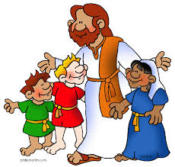
Benediction

Slide 22

VT 644
Healer of our ev’ry ill, light of each tomorrow,
give us peace beyond our fear, and hope beyond our sorrow.
You who know our fears and sadness, grace us with your peace and gladness.
Spirit of all comfort, fill our hearts.
Text and Music: Marty Haugen, 1986. ©1987 GIA Publications, Inc. Reprinted & Streamed with permission under One License A-740029. All rights reserved.

Slide 23
Healer of our ev’ry ill, light of each tomorrow,
give us peace beyond our fear, and hope beyond our sorrow.
In the pain and joy beholding how your grace is still unfolding,
Spirit of all kindness, be our guide.

Slide 24
Healer of our ev’ry ill, light of each tomorrow,
give us peace beyond our fear, and hope beyond our sorrow.
You who know each thought and feeling, teach us all your way of healing,
Spirit of compassion, fill each heart.
Healer of our ev’ry ill, light of each tomorrow,
give us peace beyond our fear, and hope beyond our sorrow.

Slide 25
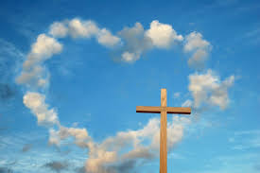
Passing the Peace

